Slide 1
Project Presentation
Car Price Prediction

Slide 2
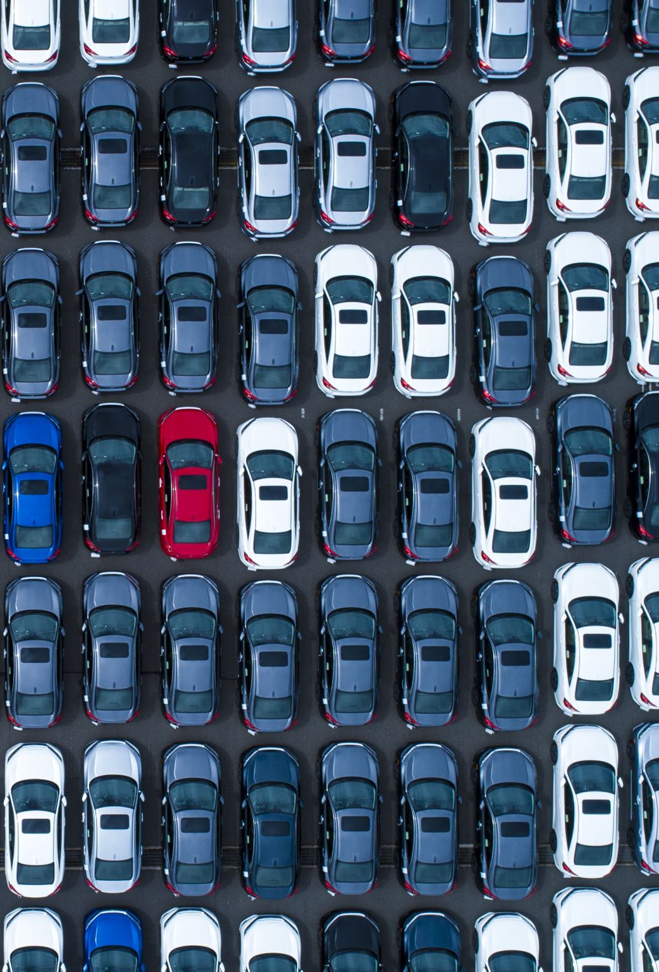
PROBLEM STATEMENT
A model to predict the price of a used car should be developed in order to assess its value based on a variety of characteristics. Several factors affect the price of a used car, such as company, model, year, transmission, distance driven, fuel type, seller type, and owner type. As a result, it is crucial to know the car's actual market value before purchasing or selling it.

Slide 3
Outline
Why accurate prediction is important?
Understanding Dataset features
Project problem statement
Tools Used
Approach Used to solve this problem.
Key Findings
Best Model and Result
Conclusions

Slide 4
Approach or Process Involved in Analysis
Data analysis
Feature Engineering
Relation between different features and Used Car price.
Group Data Analysis to get more insights.
Correlation and identification of multicollinearity problem.
Data pre-processing.
Model Initialization and evaluation.
Model Validation
Model Testing and Pipelining.

Slide 5
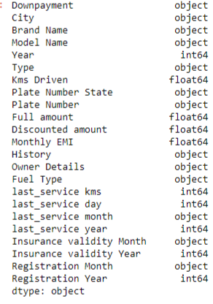
Exploratory data analysis
Total rows in data set: 5041
Columns: 23
Column names and Datatypes:

Slide 6
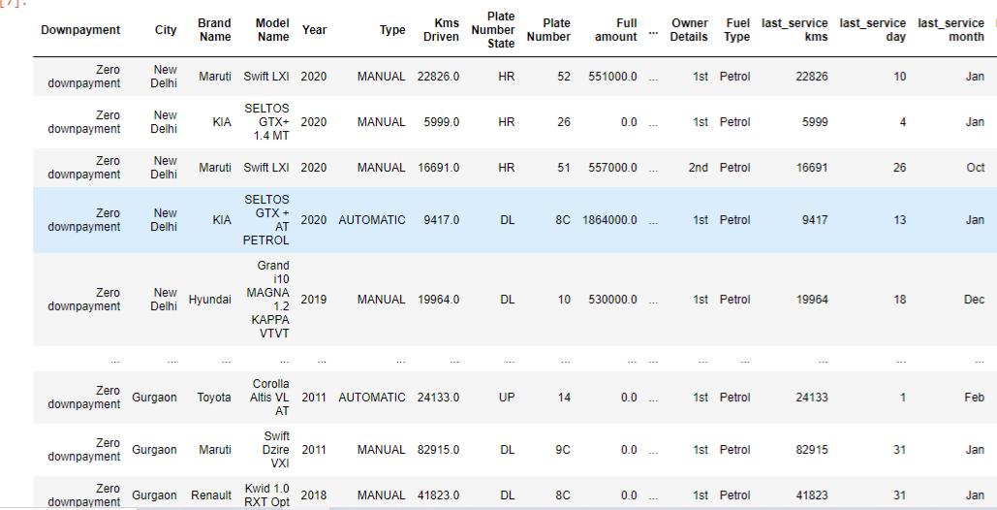
Dataset

Slide 7
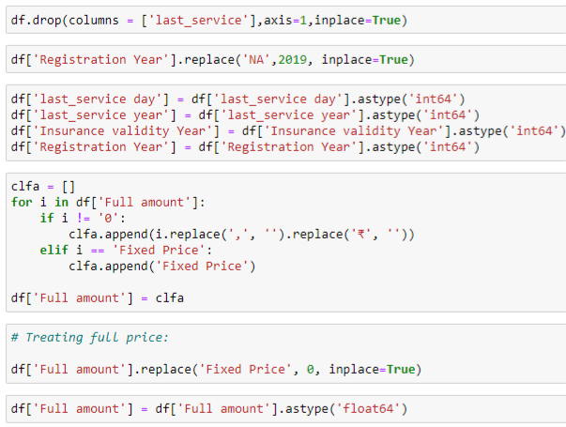
Feature Engineering
As the data set was grabbed from the website in the raw form so we have to apply lots of data cleaning techniques to get the best out of data.
These steps included treating null values converting data type of columns using splitting and stripping techniques on the strings and much more.

Slide 8
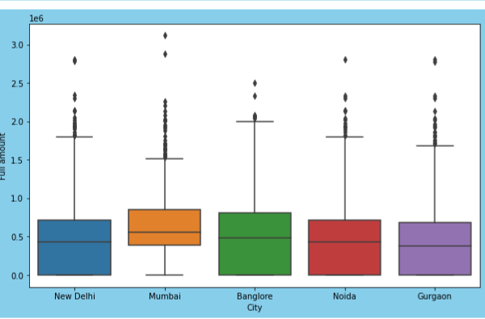
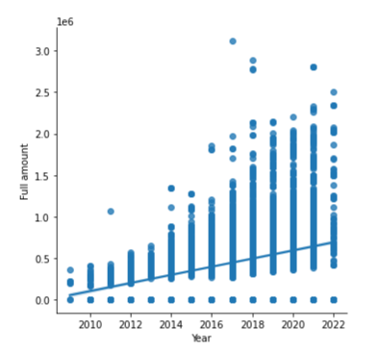
Data Visualization
Univariate analysis:
Data frequency distribution analysis plots:
Distribution plot.
KDE plot.
Bivariate Analysis
BoxPlot
LMplot
Multivariate analysis
VIF analysis
Heatmap analysis for multicolinearity

Slide 9

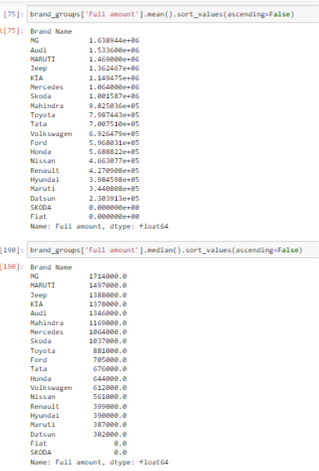
Grouped Data Analysis to get more insights.
High priced features:
Deisel and petrol Cars
Suv cars
Maruti/Audi/brand cars
1st/Owner cars/comparitively less driven cars
Used car prices in metropolitan cities is high.

Slide 10
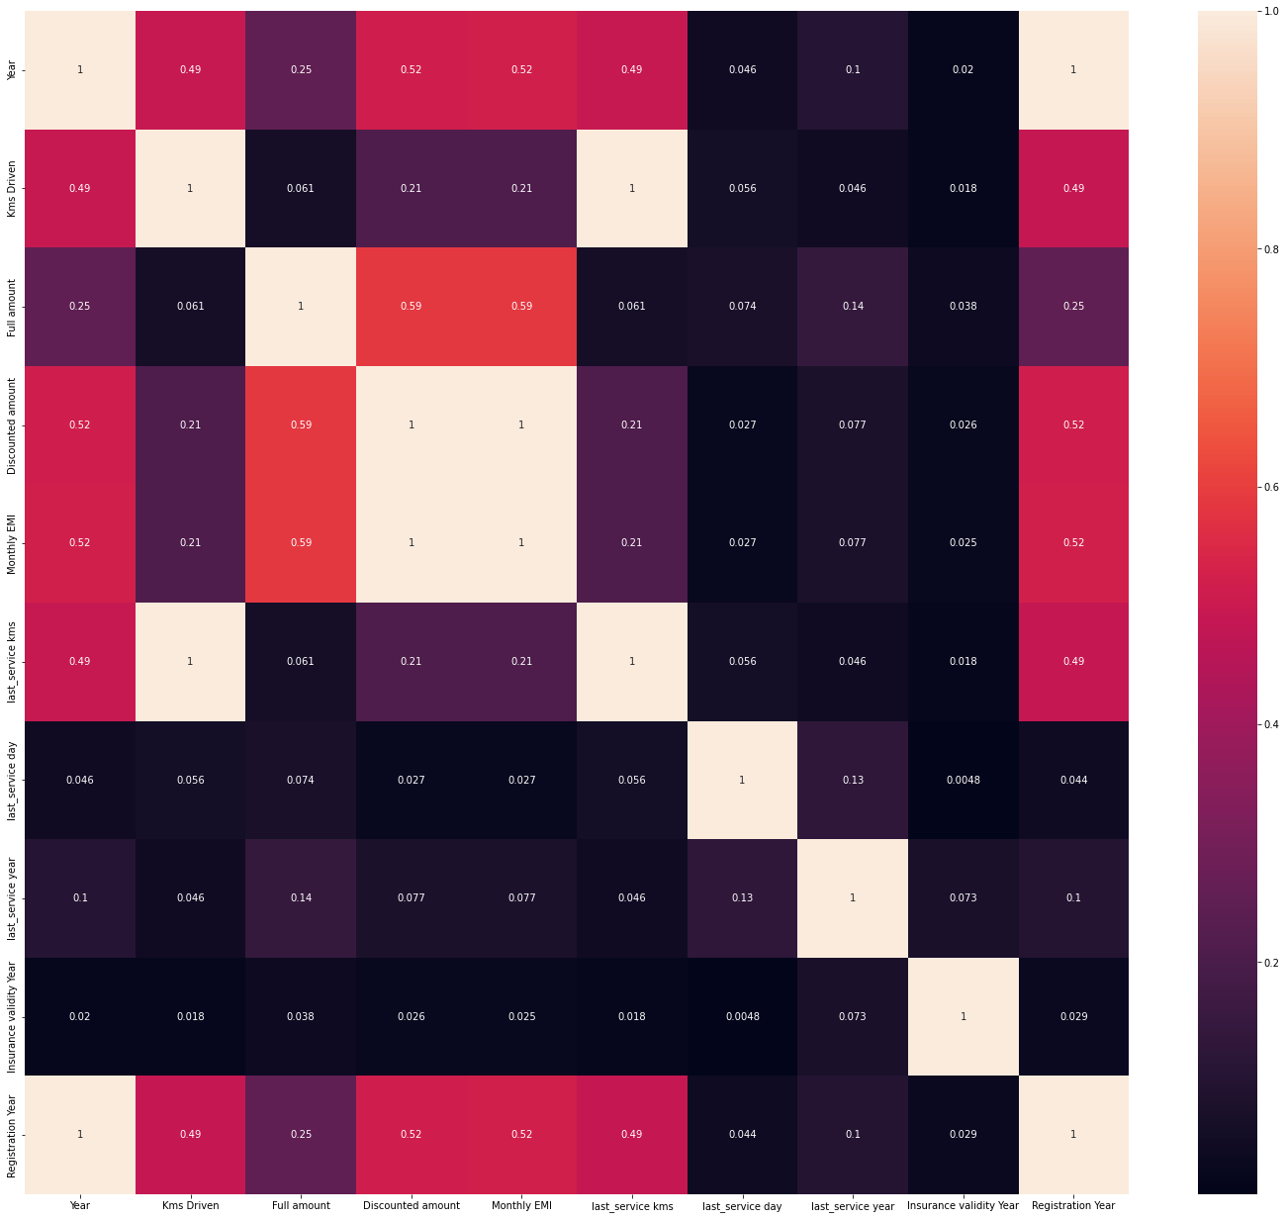
Correlation and identification of multicollinearity problem

Slide 11
Result of Data Analysis
In the used cars marketplace, car prices vary up to 31,00,000 rupees depending upon various features such as car brand, model, kilometre driven, registration year, etc. some brands are overpriced as compared to others such as Maruti and Audi. one should avoid buying diesel operated used cars as they are overpriced.
Titanium AT 4 x 4 is the most expensive vehicle in the used cars collection with staggering value of up to 31,00,000. Diesel petrol and petrol plus CNG vehicles have higher values with diesel vehicles being most overpriced. From the data set of used cars Maruti and Hyundai are the most used cars that are sold in the market.
Fiat Mercedes and skoda are the cars that have been sold very less in the used cars marketplace. Mg Audi and Maruti have the highest prices in the used cars marketplace.
As our used cars data set contains lot of outliers predicting used car prices very accurately was a tough objective but by using xg boost that is a boosting technique we have got a very good 99 percent plus accuracy in the training data set with up to 85% accuracy on the test data set.
The average value of a used car from our data set is coming out to be around movie ₹70,00,000 whereas the mean absolute value of error is ₹50,000.
We have also Tested our model by cross validation method in which our model accuracy among different subsets of the data is also uniform that means with such data we can rely on our model and its prediction keeping in mind the error.

Slide 12
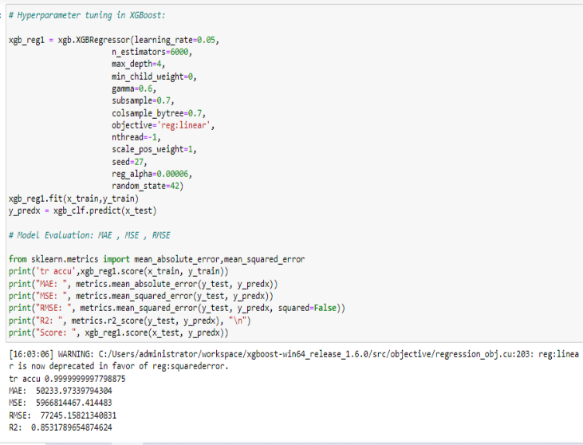
Model Initialization and evaluation
The best best model is xgboost classifier model that harness the accuracy of 99% on the training data integrity accuracy and more room for improvement on the testing data.

Slide 13

Conclusion
Using data mining and machine learning approaches, this project proposed a scalable framework for Indian used car market. cars24.com website was scraped using the selenium library to collect the benchmark data. An efficient machine learning model is built by training, testing, and evaluating various regressor models. As a result of pre-processing and transformation, XGBoost Regressor came out on top with 99% accuracy on the training data and 85 % acuuracy on the test data followed by Ensemble Regressor with 84%. Each experiment was performed in real-time within the jupyter environment. In comparison to the system's integrated Jupyter notebook and Anaconda's platform, algorithms took less training time in Google Colab.

